Slide 1
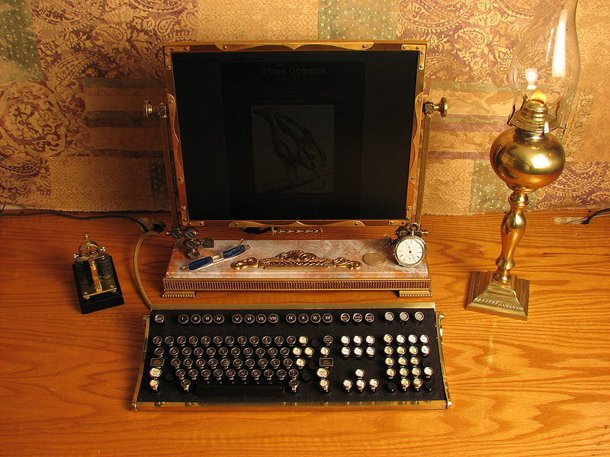

UNIX and C
(Thedsadude)
(Jake vonSlatt, Steamtop, 2007)
Steven Bradley

Slide 2
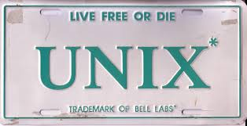

Slide 3

1958
Antitrust case settlement forbids AT&T from them selling computer products

Slide 4

1964
MULTICS (Multiplexed Information and Computing Service) project started
MIT + GE + Bell Labs

Slide 5
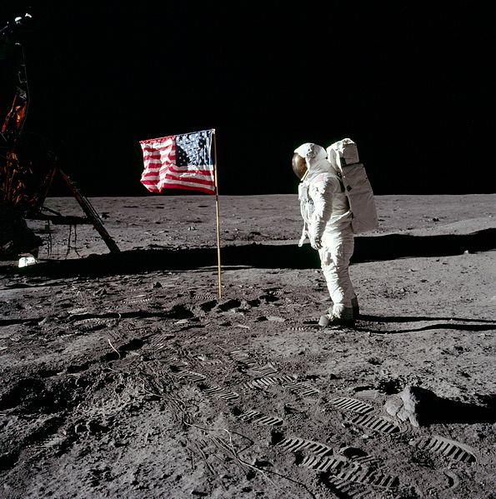
1969
UNICS (Uniplexed Information and Computing Service)
AT&T Bell Labs
Ken Thompson
Dennis Ritchie
Brian Kernighan
Douglas McIlroy
Michael Lesk
Joe Ossanna

Slide 6

1972
UNICS becomes UNIX
Originally written in assembly
Rewritten in C by 1973

Slide 7

1974
UCB (Berkeley, California) start their own development
This eventually becomes BSD (1978)
BSD Licence allows for any use

Slide 8

1981
MSDOS launched

Slide 9

1982
Bill Joy of BSD co-founds Sun (eventually makes Java)
Solaris becomes widely adopted by late 90s but declines.

Slide 10

1983
AT&T disband Bell labs after new anti-trust case
Now free to commercialise UNIX V
GNU launched by Richard Stallman under GPL - not yet a stable system

Slide 11

1991
Linus Torvalds starts writing Linux for x86

Slide 12

1997
Apple choose NEXTSTEP, based on BSD for Macintosh

Slide 14
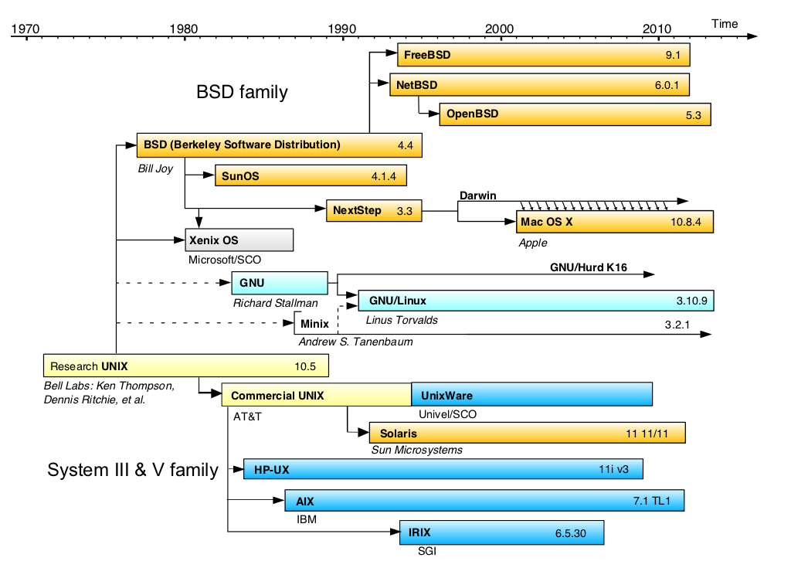
(highly simplified!)

Slide 15
An example UNIX command
sort
What does it sort?
A file (if specified)
stdin: standard input, by default from terminal
Where does it put the results?
stdout: standard output, by default the terminal
A file? Not available as a parameter
Can redirect output to file with >
E.g. sort infile.txt > outfile.txt
Use >> to append rather than overwrite existing file
Can redirect input from file with <
sort <infile.txt > outfile.txt
Or … <infile.txt sort > outfile.txt

Slide 16
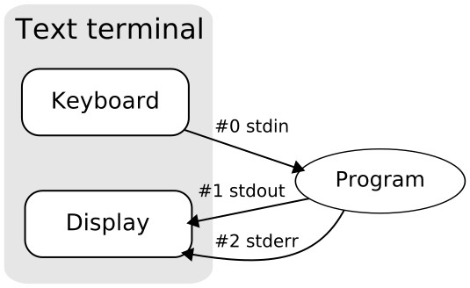
stdin, stdout and stderr
Remove the need to worry about I/O devices
Two types of output, each can be redirected
These are stream variables, can redirect e.g.
2>&1

Slide 17
Can redirect input from another program with pipe |
wc * | sort
wc (word count) counts lines, words and chars in file
Can sort by number (instead of lexicographically) with sort –n
wc * | sort –n
Can use command line as simple editor with cat
cat > outfile.txt
cat concatenates all its input files (or stdin) to stdout
Use Ctrl-D for EOF

Slide 18
More unix commands
tr
translates or deletes characters from SET1 to SET2
e.g. tr 'A-Z' 'a-z' makes a lower case version of stdin
option –c takes complement of SET1
option –s squeezes repeats to a single char

Slide 19
uniq
Remove or report repeated lines
Use with sort to find lines repeated throughout document
E.g. sort | uniq
Use –c option to count number of repetitions
Tie these all together: what does this do?
tr 'A-Z' 'a-z' < infile | tr -cs 'a-z' '\n' | sort |
uniq -c | sort -n

Slide 20
Summary
UNIX is written in C
stdin/ stdout/ stderr provide hardware independent IO
Can redirect input and output
Use C to write new programs for UNIX
For interpreted equivalent try shell script or perl

Slide 21
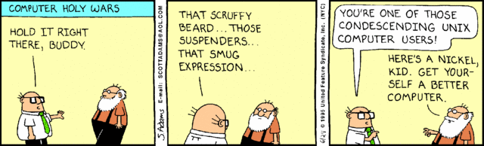

Slide 22
UNIX at Durham
Logging in via Windows DUDE
x2go app
putty/ssh to mira
J drive as home directory

Slide 23
UNIX on your machine
dual boot
OSX
Cygwin
virtualbox
most web hosts
automate tasks done by hand

Slide 24
What now
UNIX tutorial : open of course
Try python on the command line (python3) Redirect output of python program to a file

